Slide 1
Review and Sign TSS on Production SharePoint
Tutorial Scope: Engineering/Zero Defect
13-Apr-2023 Rev. 0

Slide 2
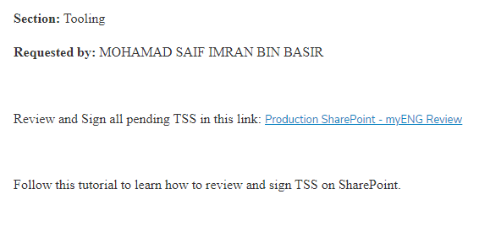
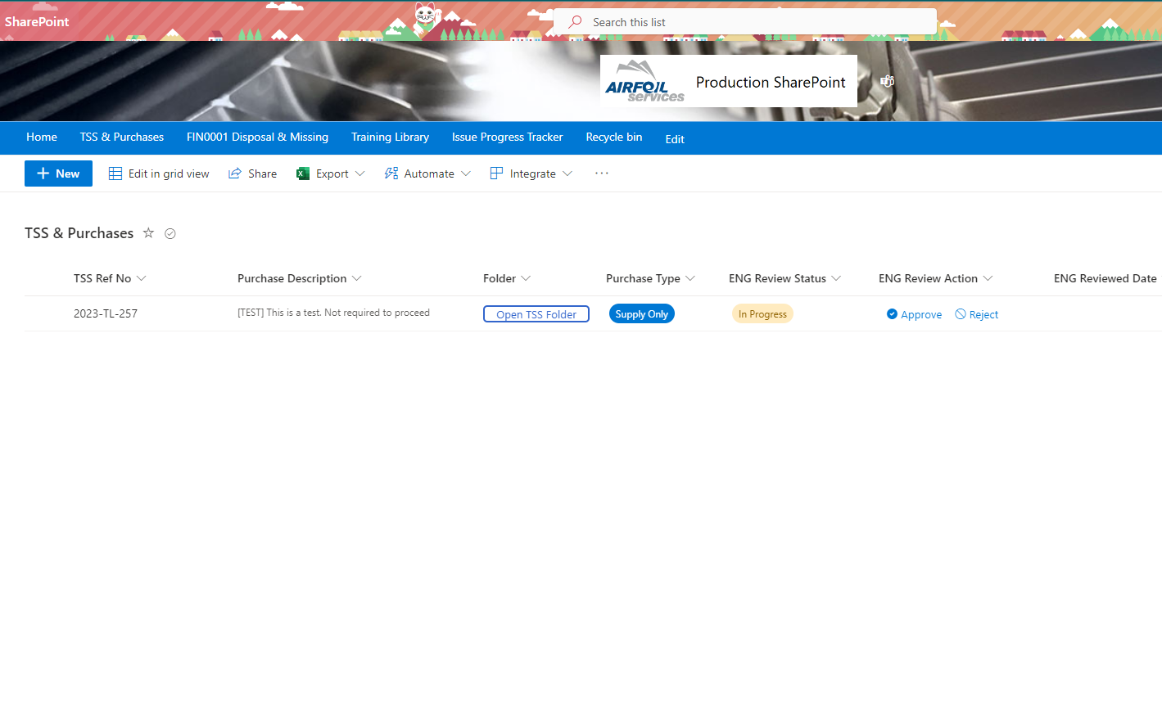
Review and Sign TSS on Production SharePoint
Tutorial 1: See all your pending TSS
1
Click the link “myENG Review” in the email notification.
You may bookmark this link in your browser for easier access.
2
Once sign in with your ASSB email, you will see all TSS listed pending for your approval.
If your list is empty, there’s no TSS pending for you!

Slide 3
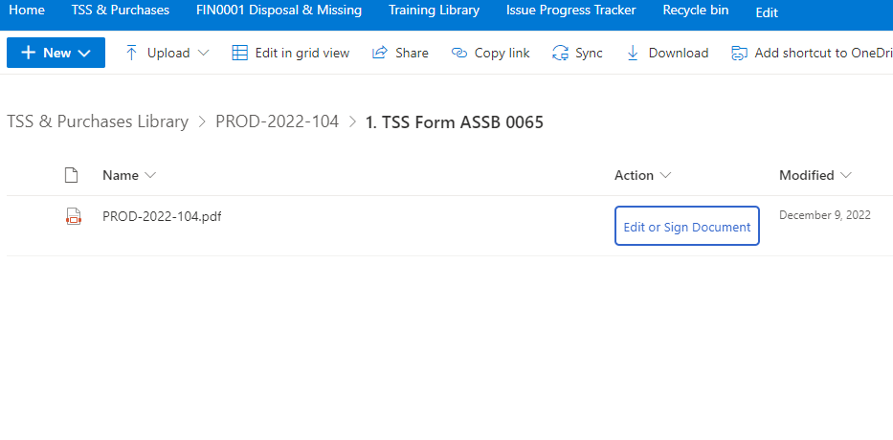
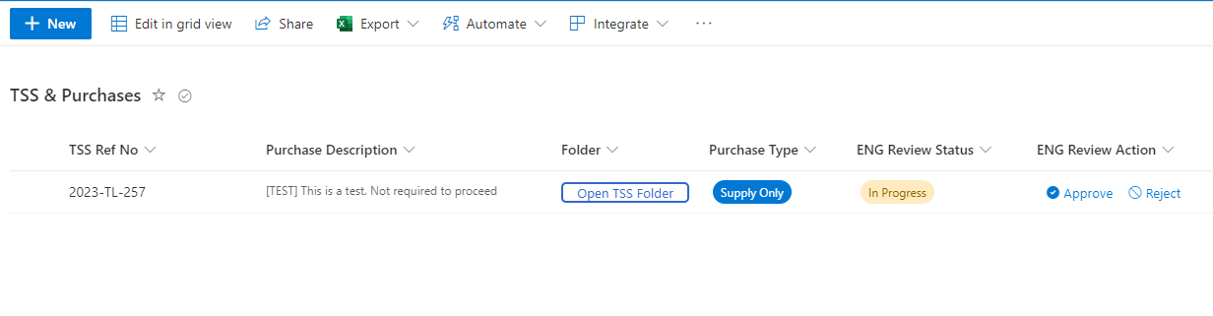
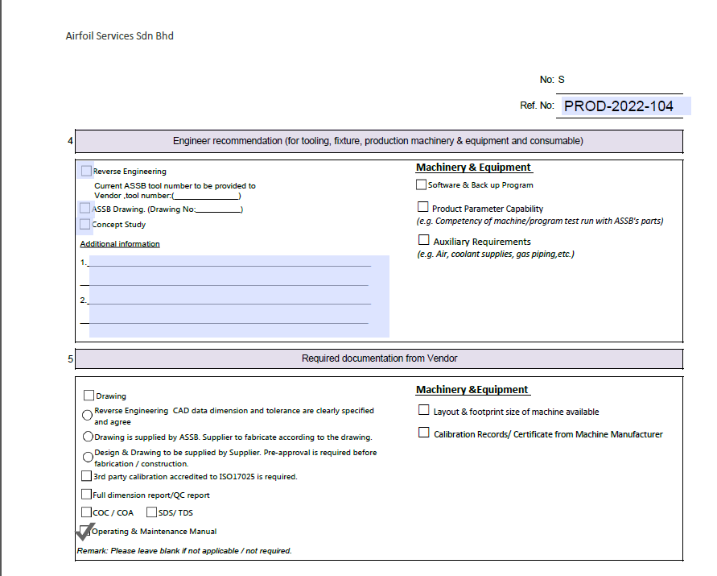
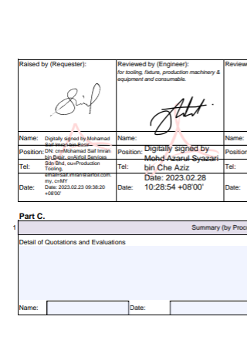
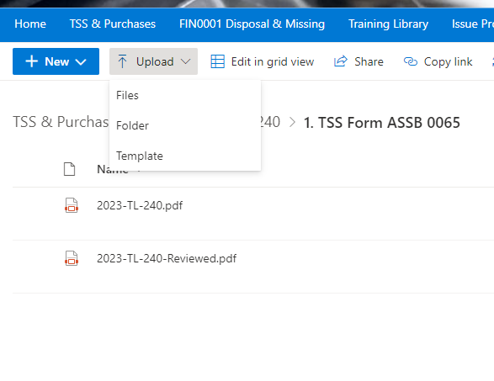
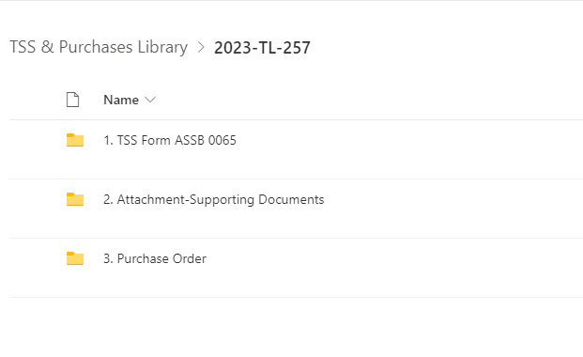
Review and Sign TSS on Production SharePoint
Tutorial 2: How to review and sign TSS (1/2)
1
4
Click the link “myENG Review” in the email notification.
You may bookmark this link in your browser for easier access.
To fill and sign the TSS, proceed to the folder no. 1, and click the “Edit or Sign Document”.
Open the downloaded TSS form.
2
5
Fill and Sign as required, then save.
Not required to put any prefix or suffix. Choose to replace the file.
Find the TSS item you want to review, and click the “Open TSS Folder”
3
6
Go back to the TSS folder no 1, select “Upload” and “Files”.
Proceed upload the signed TSS form and do the same to any another documents related to folder no 2.
Choose “Replace” when asked.
It will show the TSS folder, where:-
TSS form located in folder no.1
Failed Certs/Catalogs/List Items/Drawings are in folder no. 2

Slide 4
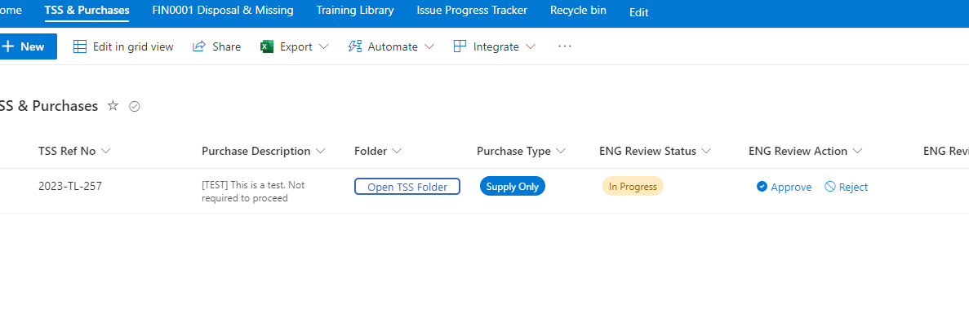
Review and Sign TSS on Production SharePoint
Tutorial 2: How to review and sign TSS (2/2)
7
Go back to the myENG Review page, find the TSS item and select “Approve” or “Reject” accordingly.
The requestor will be notified automatically.
The TSS item will not be shown afterwards.

